Slide 1
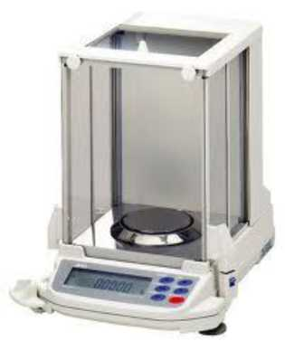
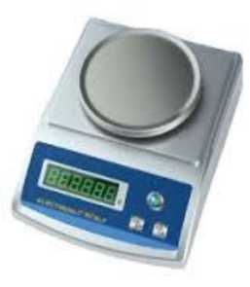
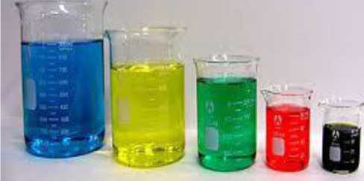
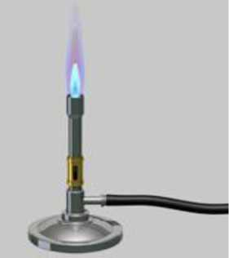
AlKarkh University of Science College of science Department of Microbiology
First year level
General chemistry Labs
Supervisor: Dr. Mohammed Abdul Baset Assistant: Anssam Dhaher Huessin
Lab -2-
General Chemistry Equipment’s
Analytical balance: an instrument for determining weight.
Beaker: used to hold liquids, multipurpose and essential in the lab.
Bunsen burner: used to heat substances.
Burette: dispensing and transferring known volumes of fluids.
4

Slide 2

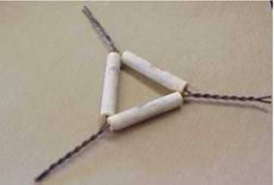
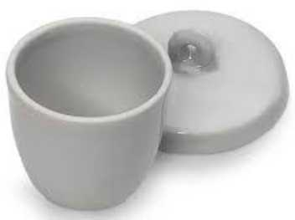

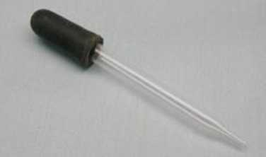
Clay triangle: used to hold a crucible while the crucible is heated.
Crucible and
temperatures.
cover: used to hold small amounts of chemicals during heating at high
Crucible tongs: to hold hot crucibles.
Dropper: Use to add drops of liquid.
Erlenmeyer flask or conical flask: used to hold liquids, has narrow neck to prevent splashes.
5

Slide 3
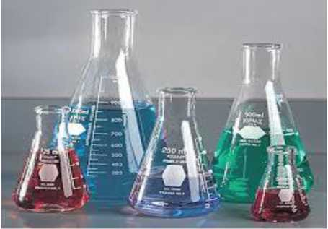

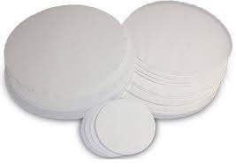
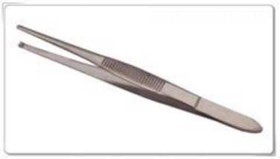
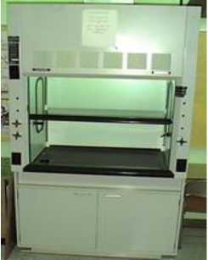
Evaporating dish: liquids are heated over a flame so that they evaporate, leaving a solid residue.
Filter paper: special paper used to separate solids from liquids.
Forceps: used to pick up or hold small items.
Fume hood: used to prevent a person from exposure to hazardous fumes from chemicals.
Funnel: for pouring liquid or other substance through a small opening.
6

Slide 4
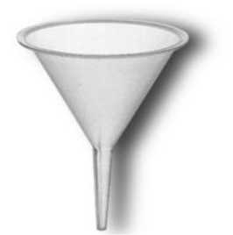
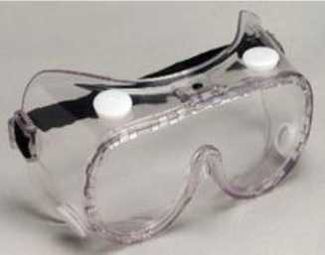

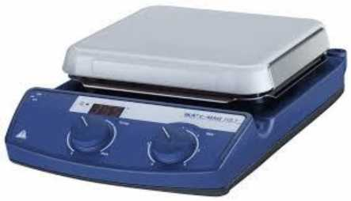
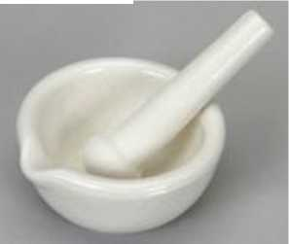
Goggles: protects eyes from chemical splashes.
Graduated cylinder: accurately measures liquid volumes.
Hot plate: used to heat and
stir substances.
Mortar and pestle: used to grind up materials
Pipet bulb: used to pull liquid up into a pipet.
7

Slide 5
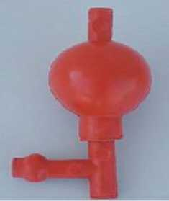
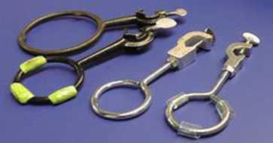
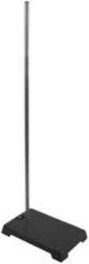
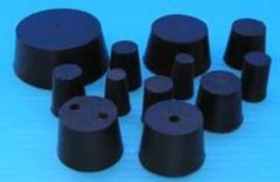
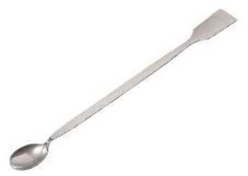
Ring clamp: used with ring stand to hold a glass container.
Ring stand: holds funnels, wire gauze above table.
Rubber stopper: used to cover ends of test tubes and flasks.
Spatula: small scoop used to transfer powder and crystal chemicals.
Spot plate: a flat plate with multiple "wells" used as small test tubes.
8

Slide 6
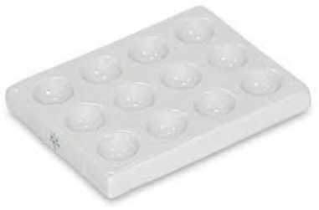

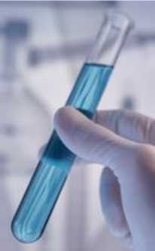
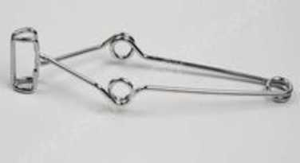
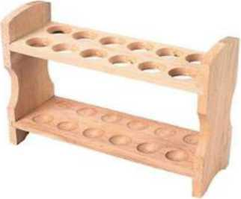
Stirring rod: used for stirring.
Test tube: open tube used to hold liquids.
Test tube clamp: clamp used to hold test-tube and other items.
Test tube rack: holds many test tubes in a row.
Thermometer: measures temperature (science uses degrees in Celsius).
9

Slide 7
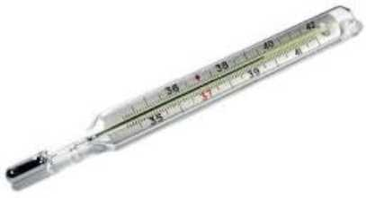
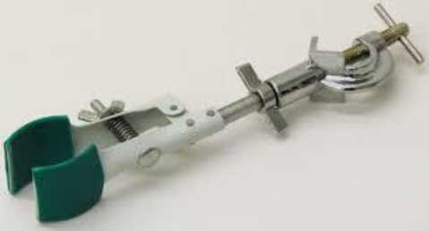
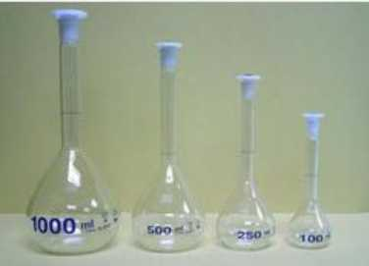

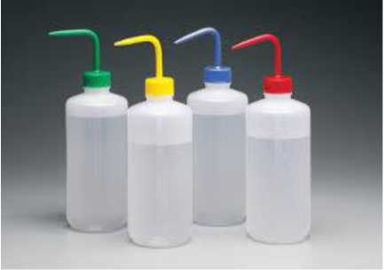
Utility clamp: used to hold laboratory glassware.
Volumetric flask: for making up solutions to a known volume.
Volumetric pipet: measures small amounts of liquids accurately.
Wash bottle: used to rinse various pieces of laboratory glassware.
Watch glass: to hold solids while being weighed, or as a cover for a beaker.
10

Slide 8
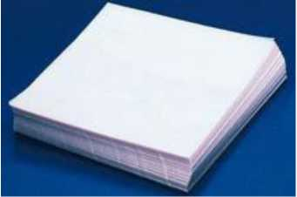
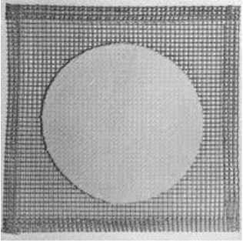
Weighing paper: used for weighing and transferring powers and crystals.
Wire gauze: used to support a container (such as a beaker or flask) during heating.
11

